Slide 1
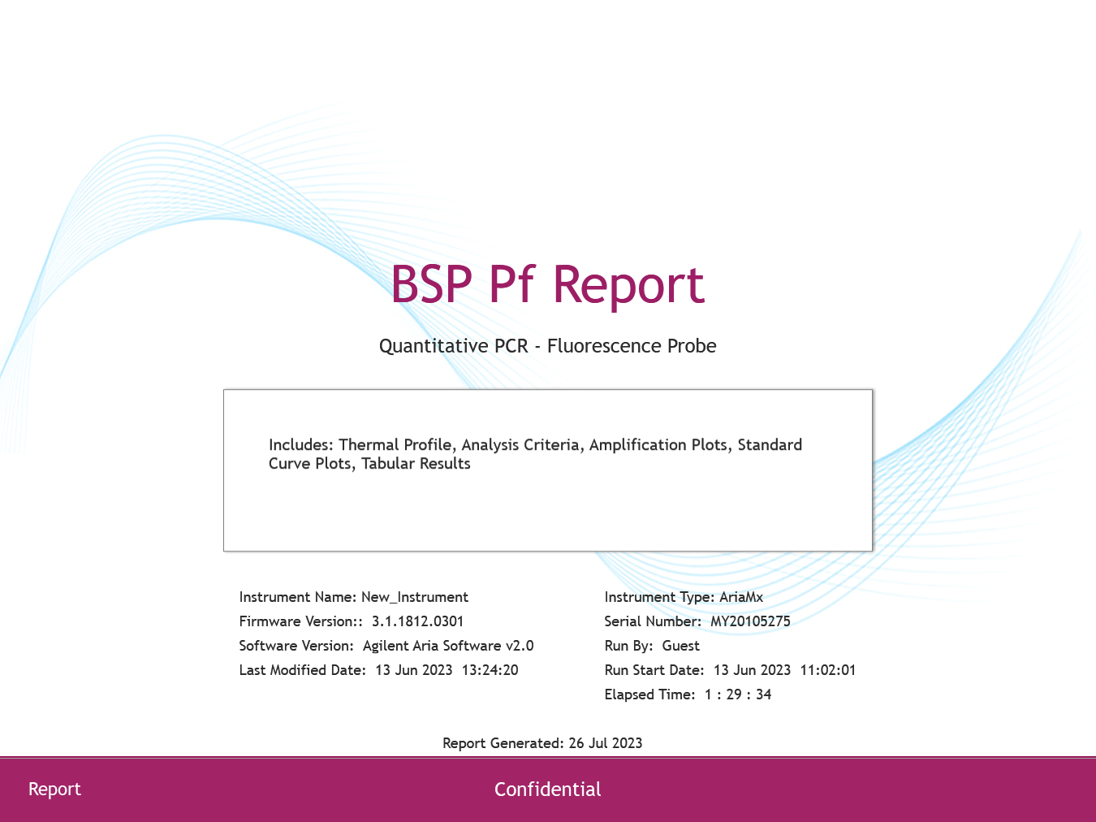

Slide 2
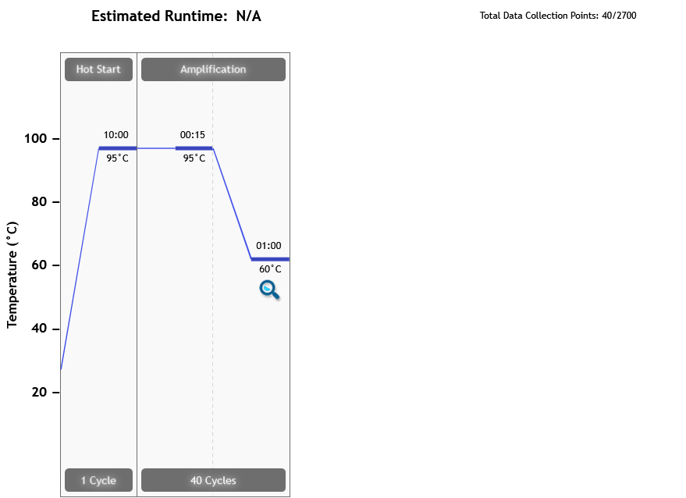
Thermal Profile
Page 2 of 8

Slide 3
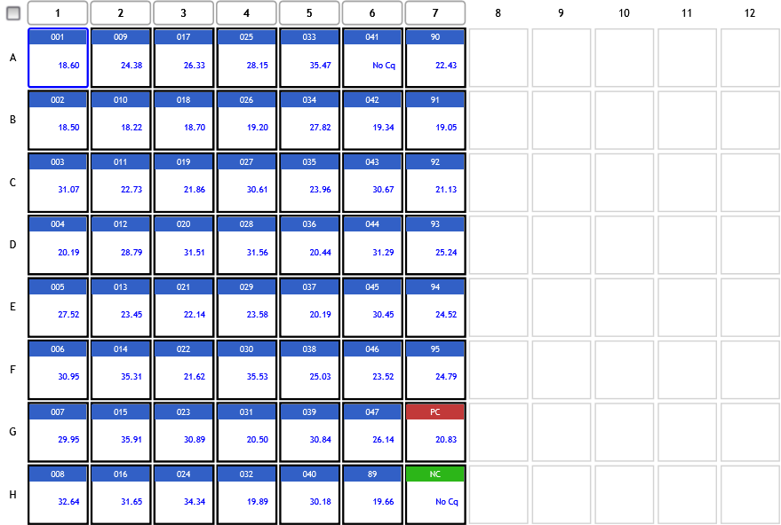
Analysis Criteria
Page 3 of 8

Slide 4
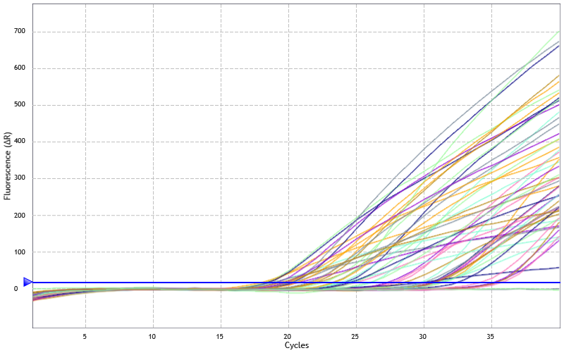
Amplification Plots
Threshold settings based on background: Start cycle = 5, End cycle = 9,
Sigma multiplier = 10, Baseline correction = Adaptive, Smoothing = On,
Crosstalk Correction: -
Page 4 of 8

Slide 5
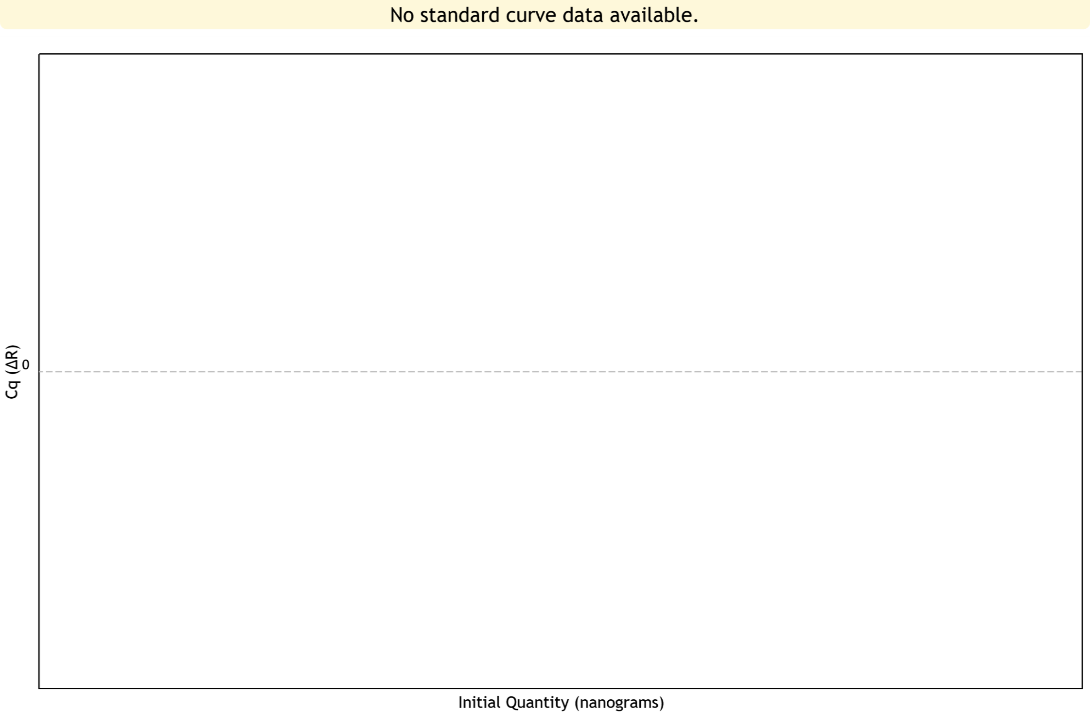
Standard Curve Plots
Confidence Level = Disabled
Page 5 of 8

Slide 6
Tabular Results (1 of 3)
Well | Well Name | Target | Cq (∆R) | Final Call (∆R)
A1 | 001 | P.falcip | 18.60 | +
A2 | 009 | P.falcip | 24.38 | +
A3 | 017 | P.falcip | 26.33 | +
A4 | 025 | P.falcip | 28.15 | +
A5 | 033 | P.falcip | 35.47 | +
A6 | 041 | P.falcip | No Cq | -
A7 | 90 | P.falcip | 22.43 | +
B1 | 002 | P.falcip | 18.50 | +
B2 | 010 | P.falcip | 18.22 | +
B3 | 018 | P.falcip | 18.70 | +
B4 | 026 | P.falcip | 19.20 | +
B5 | 034 | P.falcip | 27.82 | +
B6 | 042 | P.falcip | 19.34 | +
B7 | 91 | P.falcip | 19.05 | +
C1 | 003 | P.falcip | 31.07 | +
C2 | 011 | P.falcip | 22.73 | +
C3 | 019 | P.falcip | 21.86 | +
C4 | 027 | P.falcip | 30.61 | +
C5 | 035 | P.falcip | 23.96 | +
C6 | 043 | P.falcip | 30.67 | +
C7 | 92 | P.falcip | 21.13 | +
D1 | 004 | P.falcip | 20.19 | +
D2 | 012 | P.falcip | 28.79 | +
D3 | 020 | P.falcip | 31.51 | +
Page 6 of 8

Slide 7
Tabular Results (2 of 3)
Well | Well Name | Target | Cq (∆R) | Final Call (∆R)
D4 | 028 | P.falcip | 31.56 | +
D5 | 036 | P.falcip | 20.44 | +
D6 | 044 | P.falcip | 31.29 | +
D7 | 93 | P.falcip | 25.24 | +
E1 | 005 | P.falcip | 27.52 | +
E2 | 013 | P.falcip | 23.45 | +
E3 | 021 | P.falcip | 22.14 | +
E4 | 029 | P.falcip | 23.58 | +
E5 | 037 | P.falcip | 20.19 | +
E6 | 045 | P.falcip | 30.45 | +
E7 | 94 | P.falcip | 24.52 | +
F1 | 006 | P.falcip | 30.95 | +
F2 | 014 | P.falcip | 35.31 | +
F3 | 022 | P.falcip | 21.62 | +
F4 | 030 | P.falcip | 35.53 | +
F5 | 038 | P.falcip | 25.03 | +
F6 | 046 | P.falcip | 23.52 | +
F7 | 95 | P.falcip | 24.79 | +
G1 | 007 | P.falcip | 29.95 | +
G2 | 015 | P.falcip | 35.91 | +
G3 | 023 | P.falcip | 30.89 | +
G4 | 031 | P.falcip | 20.50 | +
G5 | 039 | P.falcip | 30.84 | +
G6 | 047 | P.falcip | 26.14 | +
Page 7 of 8

Slide 8
Tabular Results (3 of 3)
Well | Well Name | Target | Cq (∆R) | Final Call (∆R)
G7 | PC | P.falcip | 20.83 | +
H1 | 008 | P.falcip | 32.64 | +
H2 | 016 | P.falcip | 31.65 | +
H3 | 024 | P.falcip | 34.34 | +
H4 | 032 | P.falcip | 19.89 | +
H5 | 040 | P.falcip | 30.18 | +
H6 | 89 | P.falcip | 19.66 | +
H7 | NC | P.falcip | No Cq | -
Page 8 of 8

